Slide 1

VARUN
BRANCH:-CSE
ROLL NO:-

Slide 2

IDEA
Real time experience
Loss of money
Lack of nutritious food
Health issues
Fraud brokering business

Slide 3
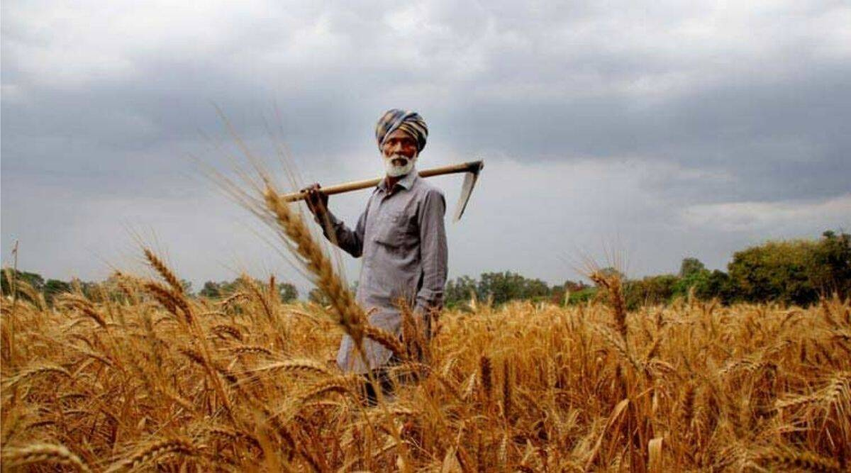
PROBLEMS FACING BY THE FARMERS
>Financial loss
>No recognition of effort
>Less profit
>Poor irrigation facilities
>Loss of life

Slide 4
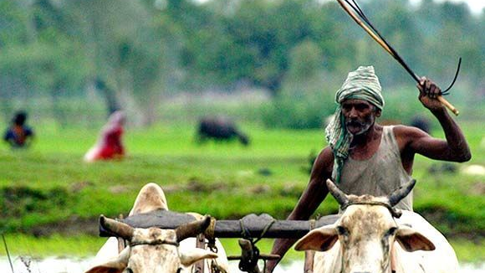
MAIN THEME
>Economic growth of farmers.
>Fresh food supply.
>Direct to home.
>No bargaining with farmers.
>Price decided by farmers.

Slide 5

LANGUAGES USED
HTML
CSS
JAVASCRIPT

Slide 6

Main interface

Slide 7
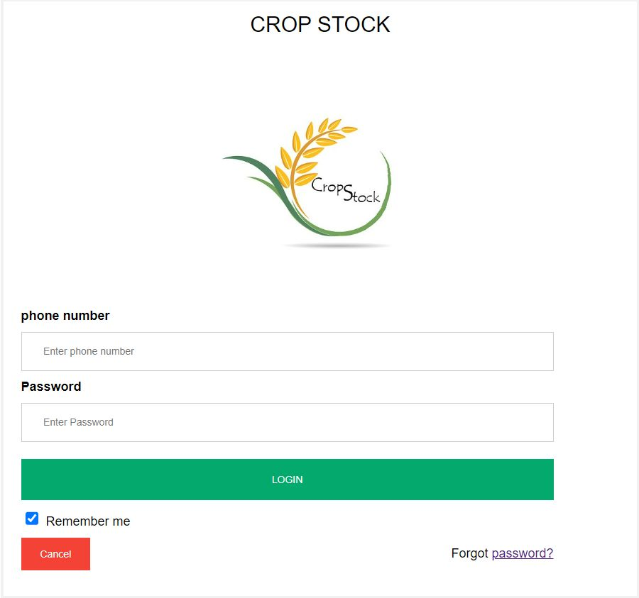
LOG IN

Slide 8
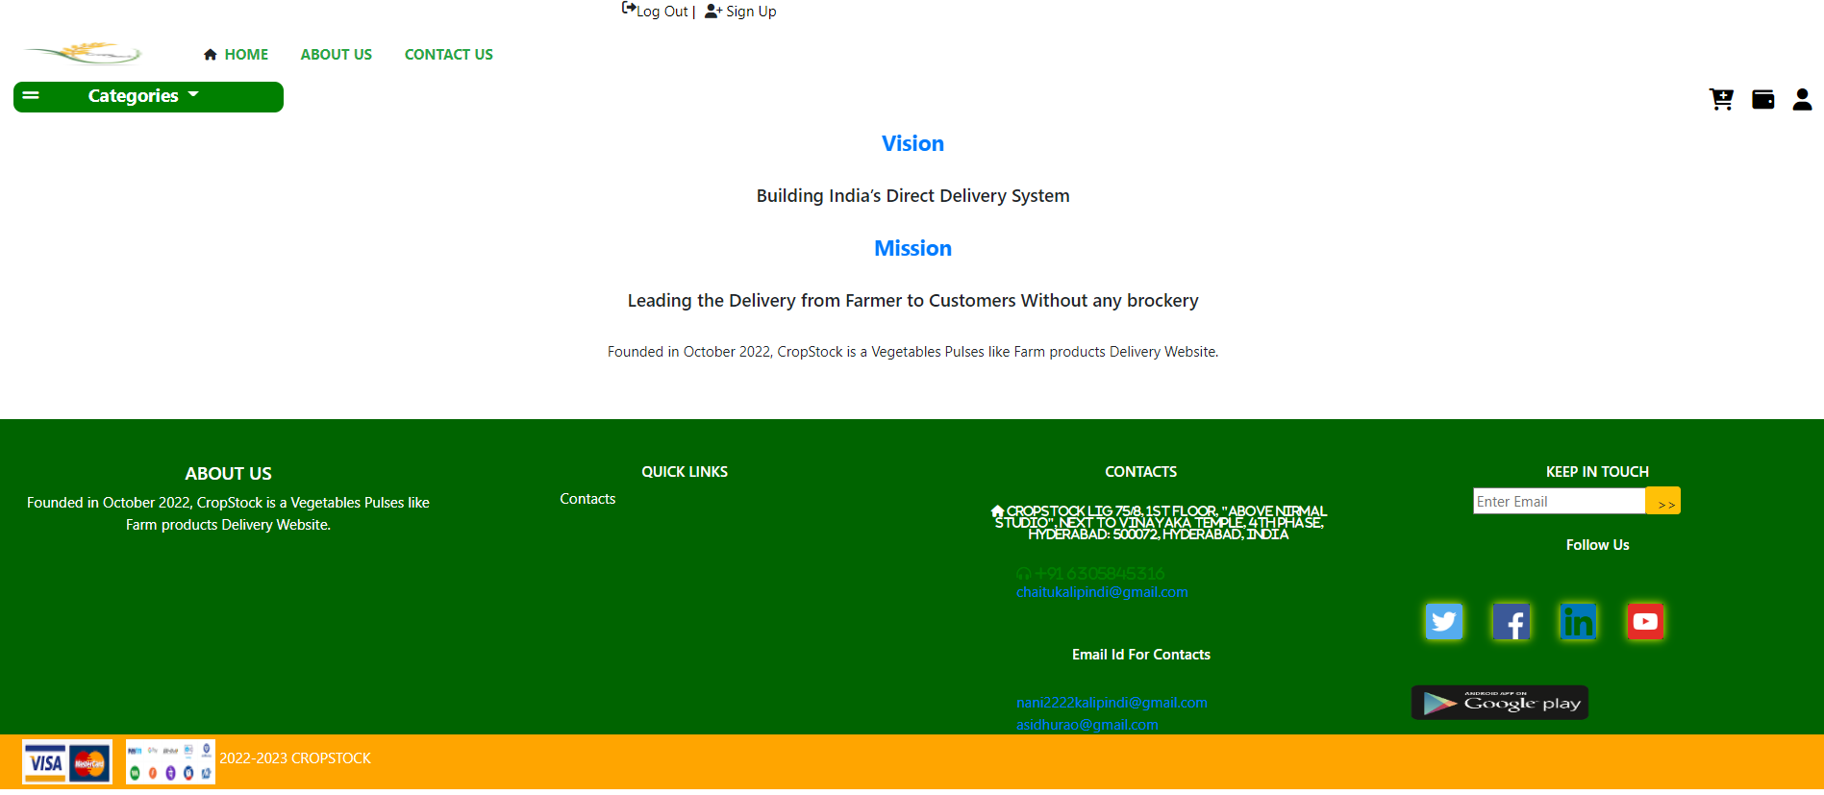
About us

Slide 9
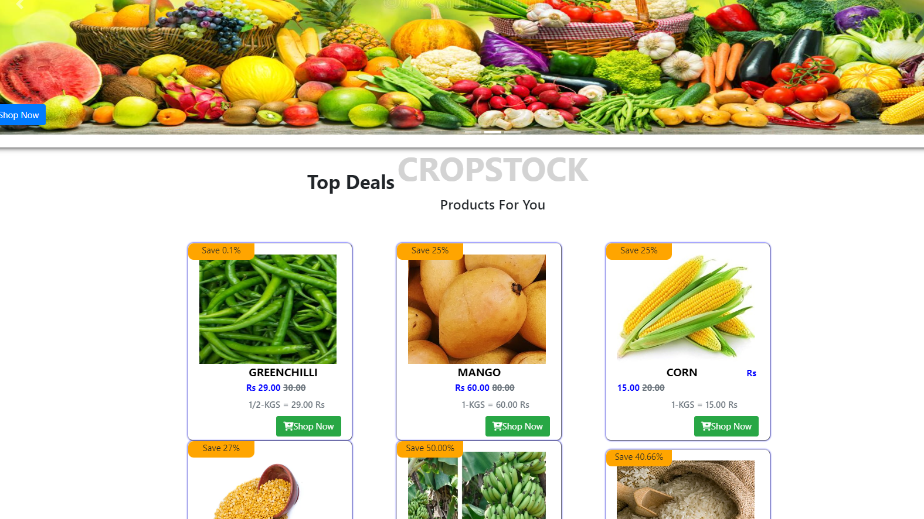
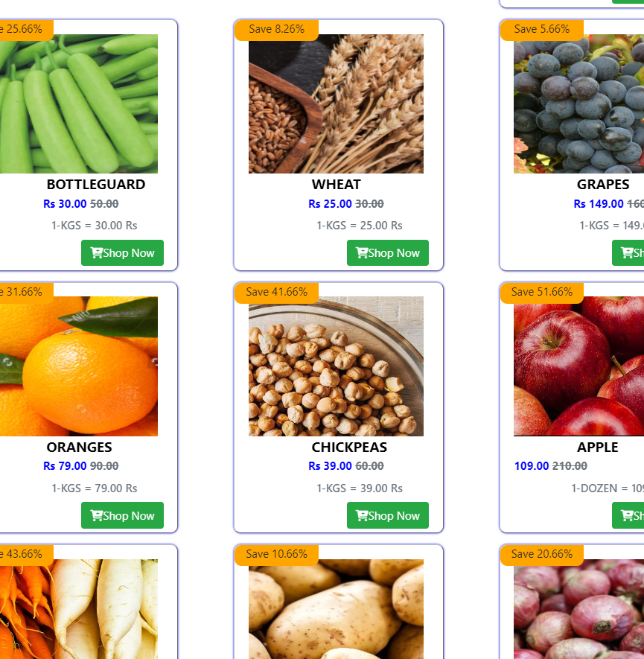
PRODUCT INTERFACE

Slide 10
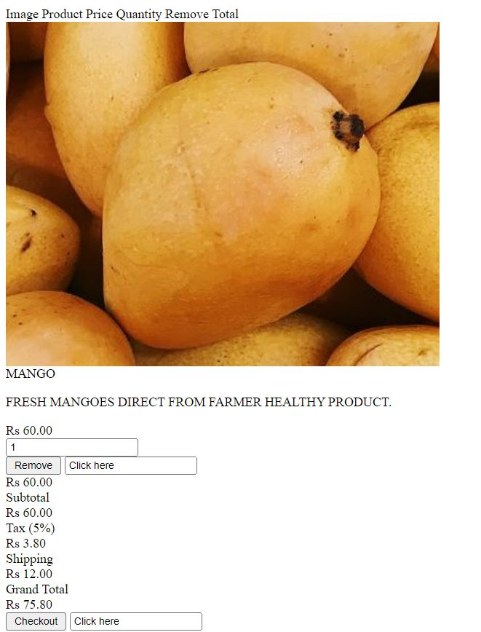
CART

Slide 11
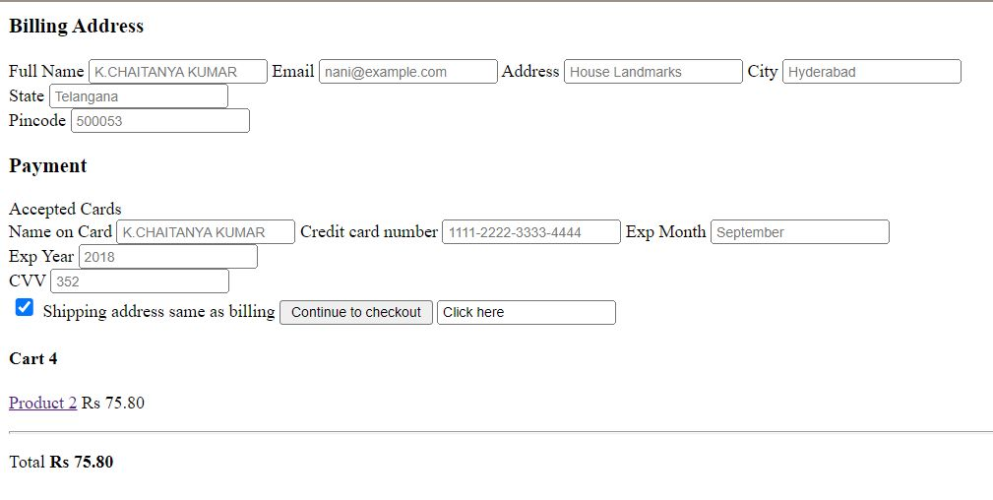
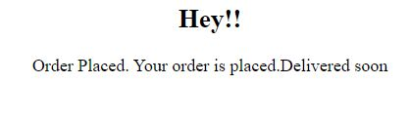

Slide 12
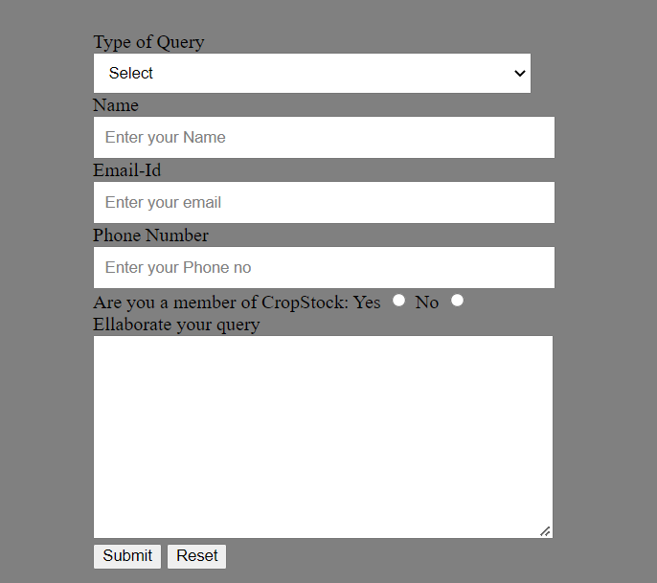
CONTACT US

Slide 13
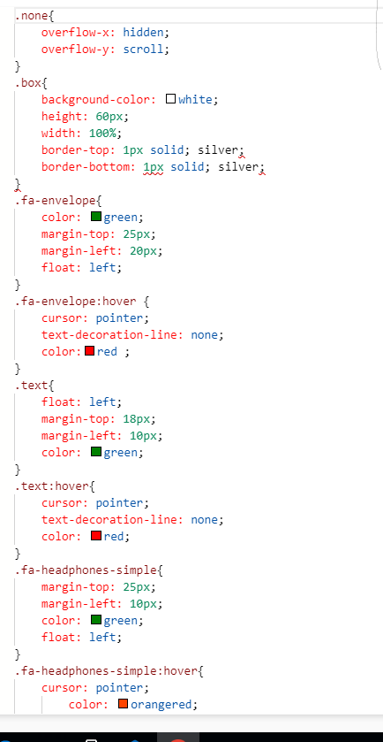
CODE

Slide 15
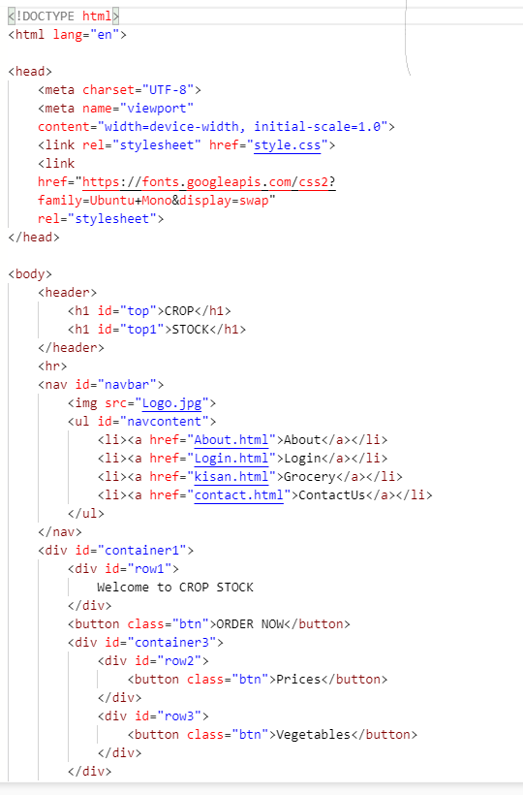

Slide 17
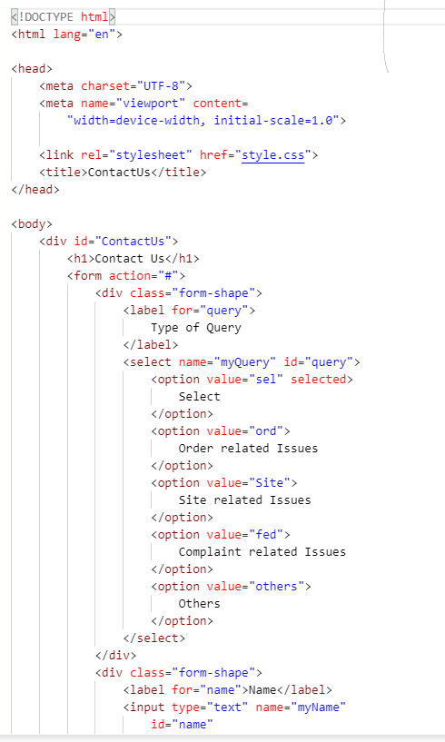

Slide 18
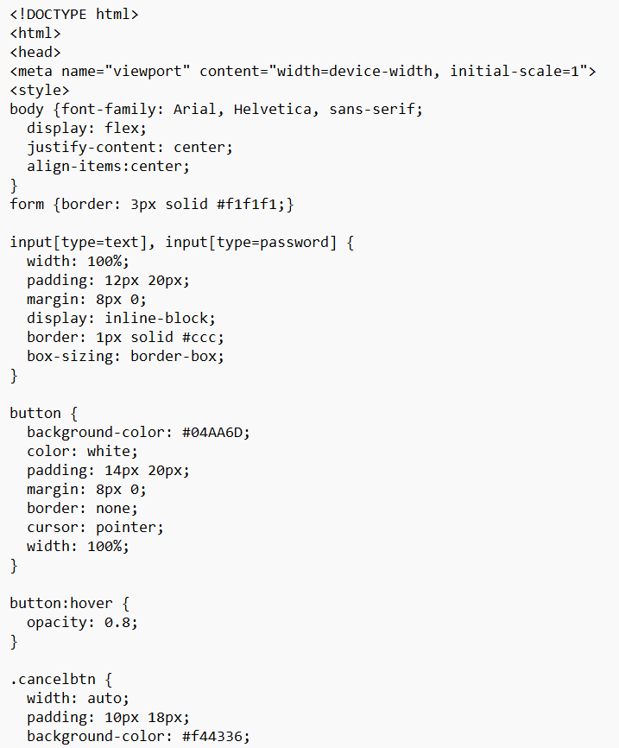
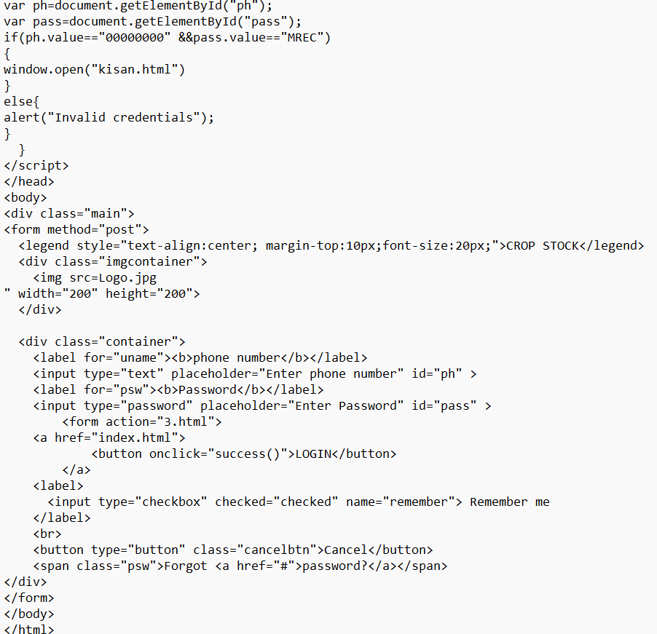

Slide 19
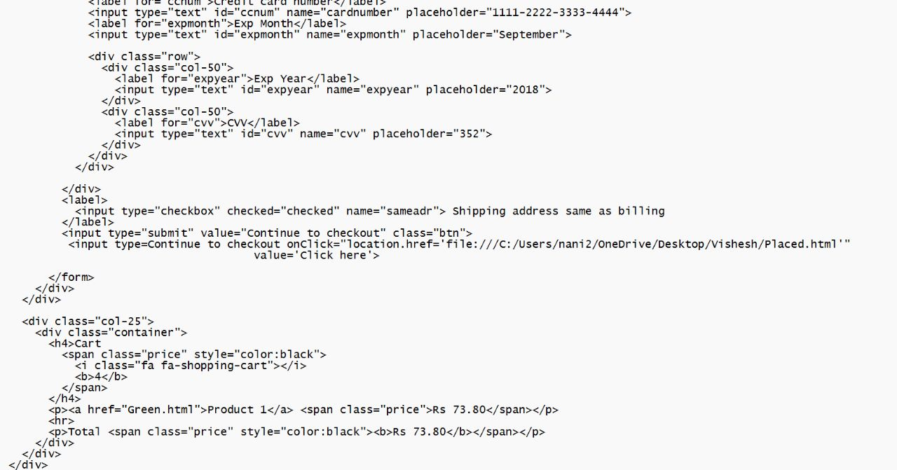
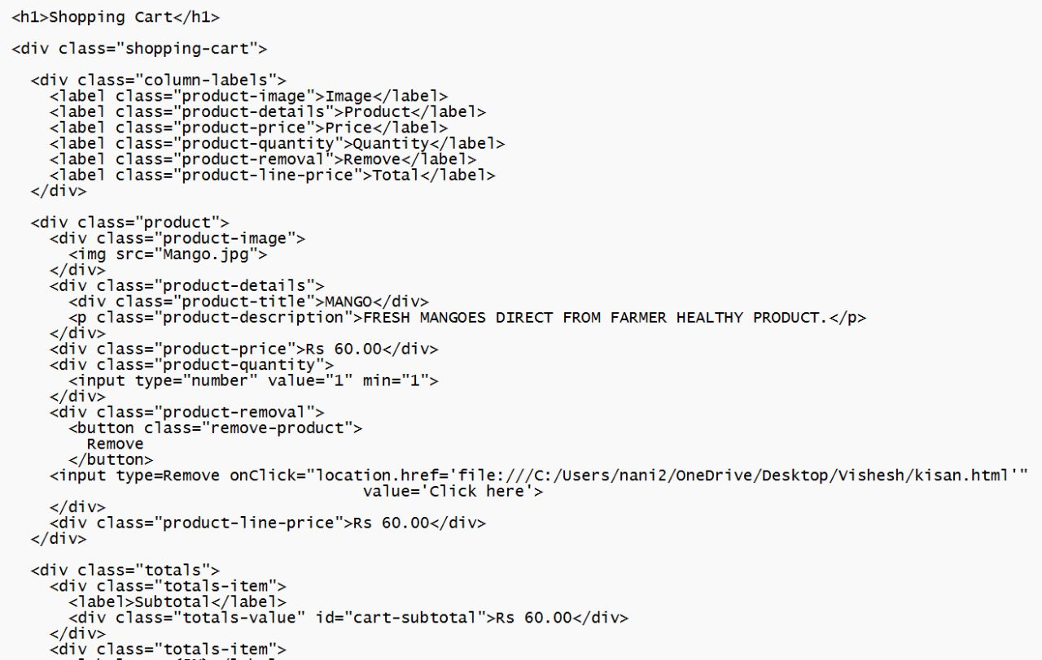

Slide 20
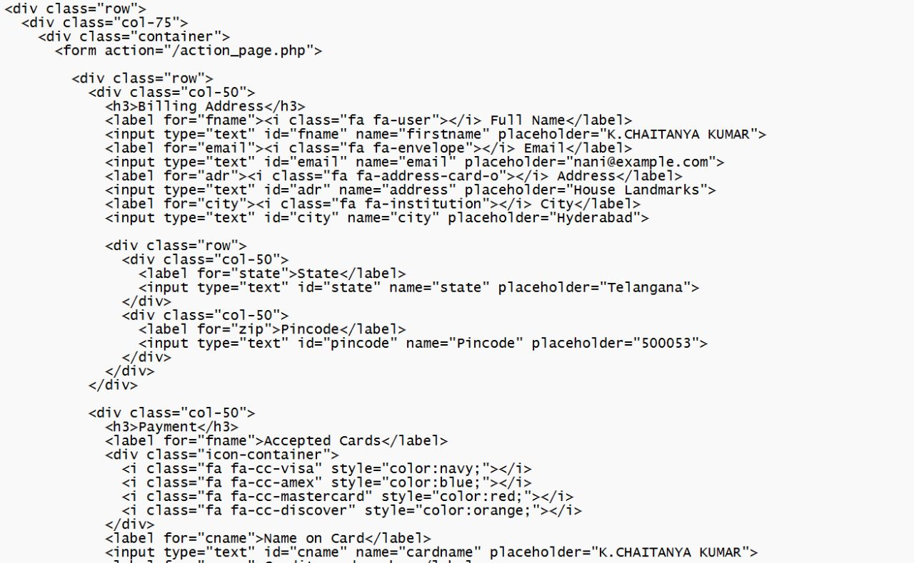
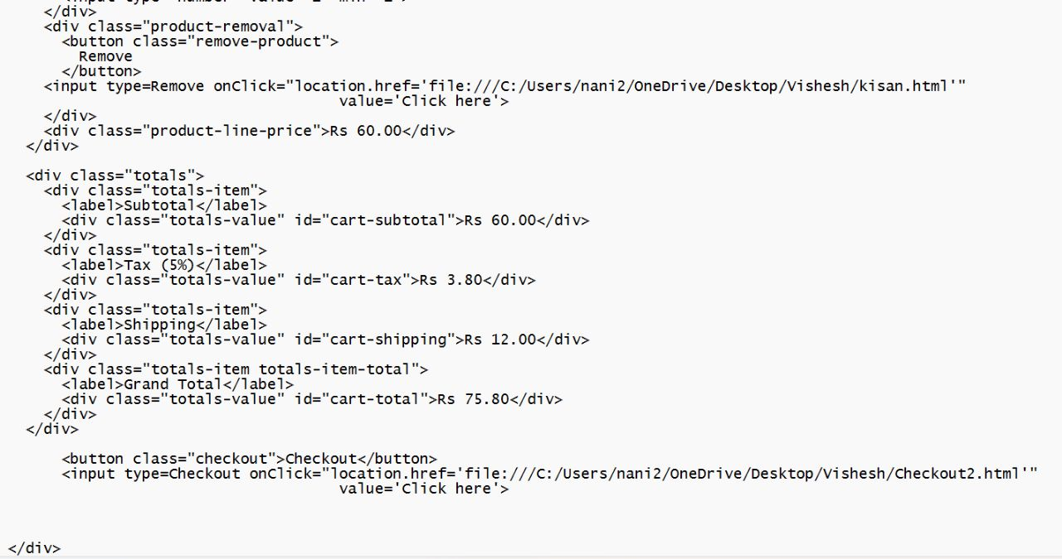

Slide 21
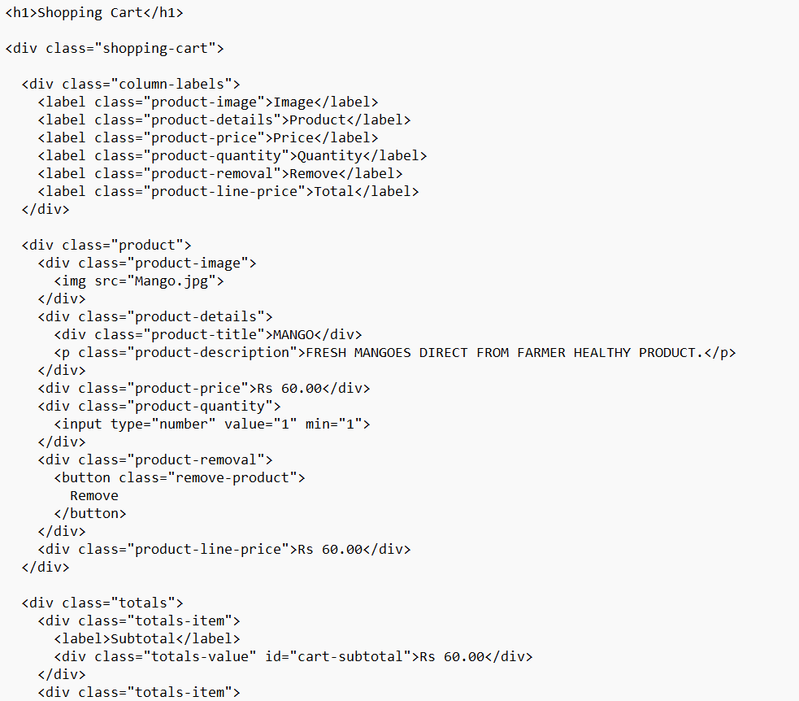

Slide 22
OUT PUT

Slide 23


